Slide 1
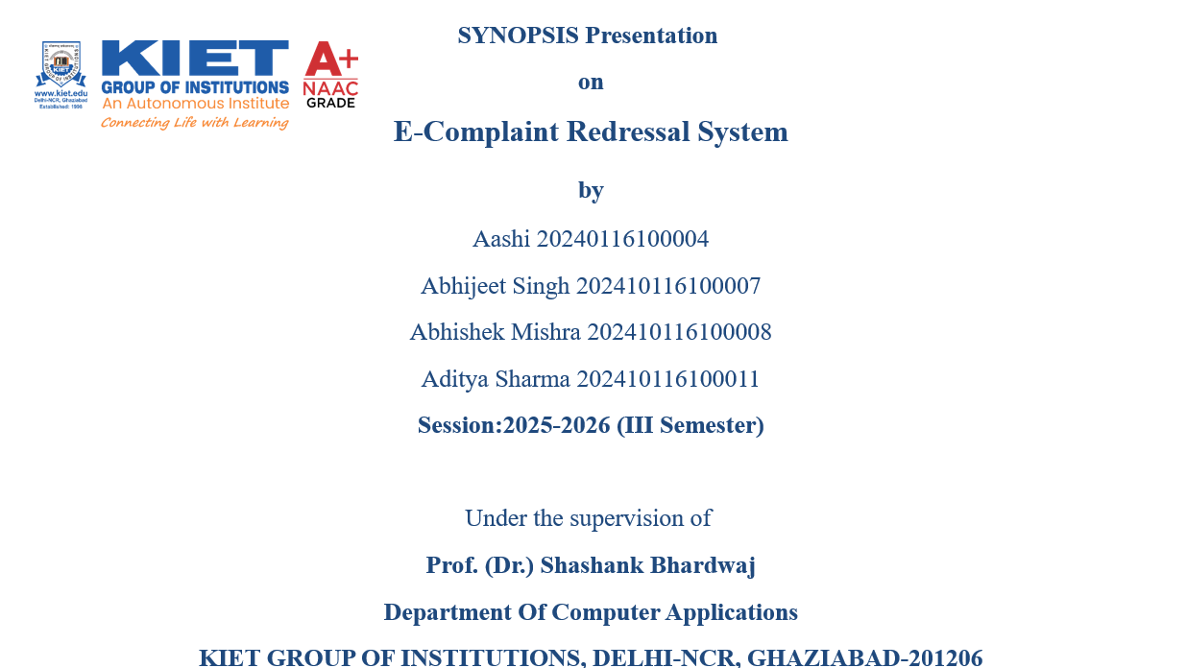

Slide 2
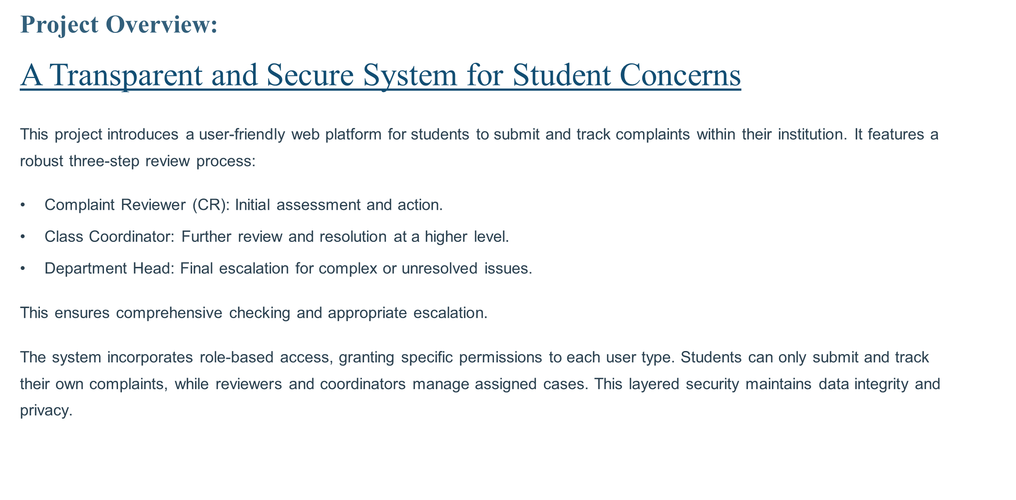

Slide 3
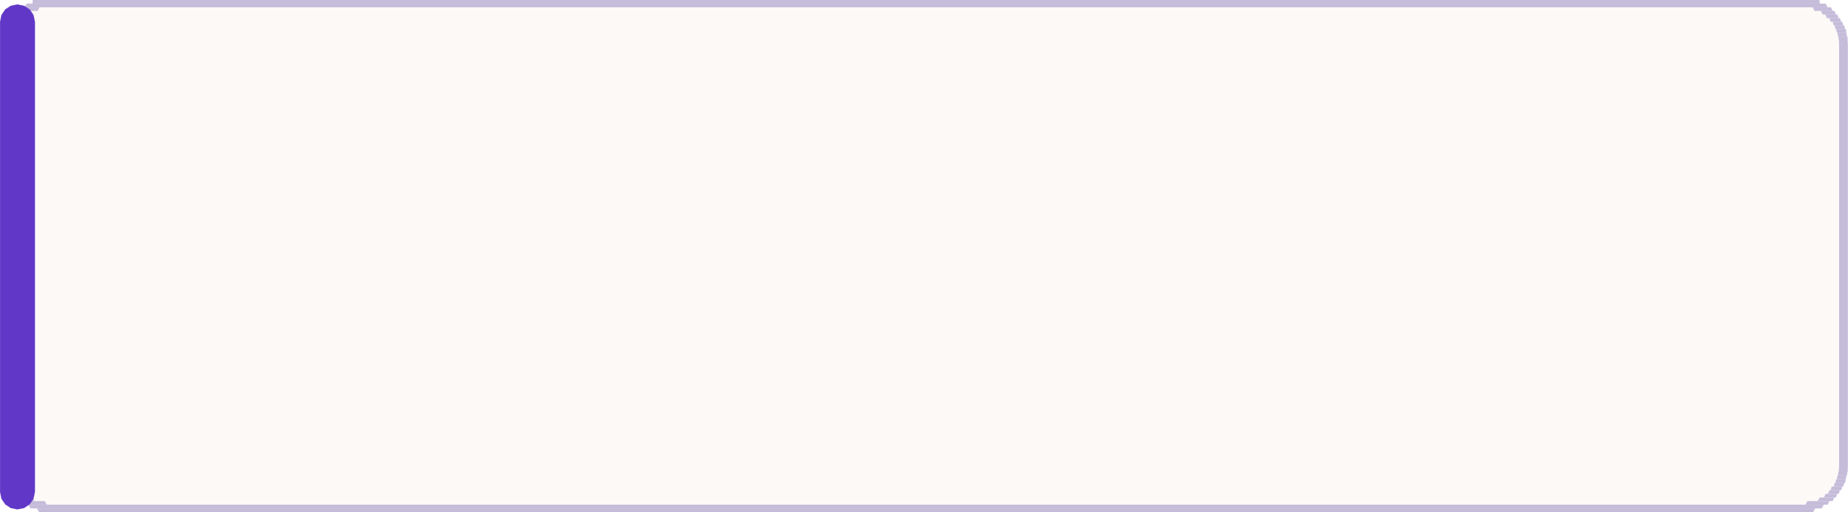
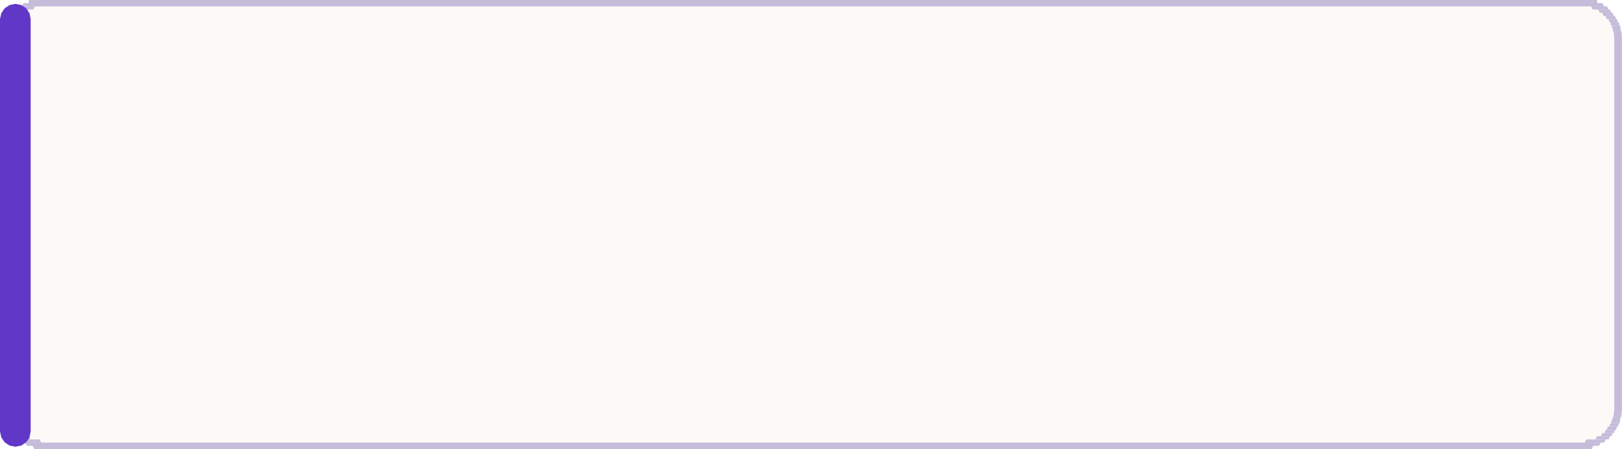




Key Project Objectives:
Enhance Accessibility
Provide a user-friendly web platform for students to easily file complaints anytime, anywhere.
Improve Transparency
Offer real-time tracking of complaint statuses and clear communication channels.
Accelerate Resolution
Implement a structured, hierarchical workflow to ensure timely and efficient complaint handling.
Boost Satisfaction
Increase student trust and satisfaction by demonstrating responsiveness to their feedback.

Slide 4
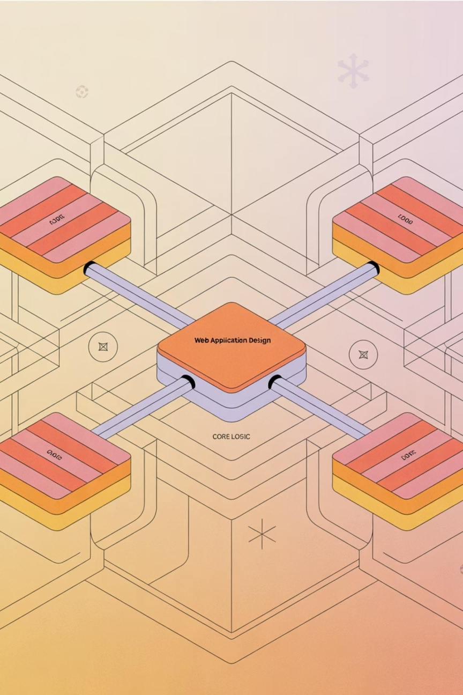

Project Scope:
Defining the Boundaries: What's
The e-complaint system focuses on core functionalities to manage student grievances effectively.
In-Scope: Student registration/login, complaint submission (with attachments), status tracking, multi-level review workflow (CR, Class Coordinator, Department), notification system, and action logging.
Out-of-Scope: Integration with external HR or payroll systems, direct disciplinary action implementation, or complex sentiment analysis of complaints. These areas may be considered in future phases.

Slide 5
Product Vision & Hierarchy
Our goal is to build a robust web platform where students can file complaints directly to their institution, fostering a transparent and accountable process. Complaints will move through a structured three-level hierarchy to ensure proper validation, classification, and resolution.
Student
Initiates the complaint process.
Complaint Reviewer (CR)
Checks validity and content.
Class Coordinator
Verifies, classifies, and forwards.
Department
Takes action and updates status.

Slide 6
Core Features
Empowering Students and Administrators
For Students
For Complaint Reviewers & Class Coordinators
Register/Login (JWT authentication)
File new complaint (title, description, category, optional attachment)
View complaint history G statuses
Receive updates/notifications on progress
Login dashboard for submitted complaints
Approve/Reject/Request edits; Assign to relevant department
Forward to next level in hierarchy
Update status ("In Progress," "Resolved"), add resolution remarks
Maintain action log for transparency

Slide 7
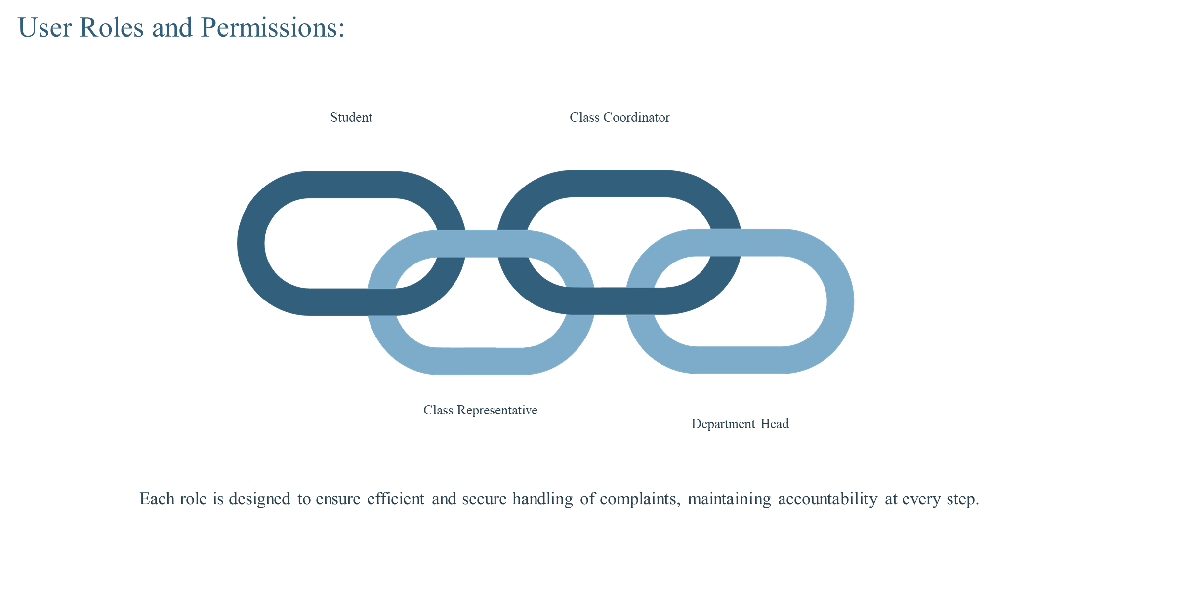

Slide 8
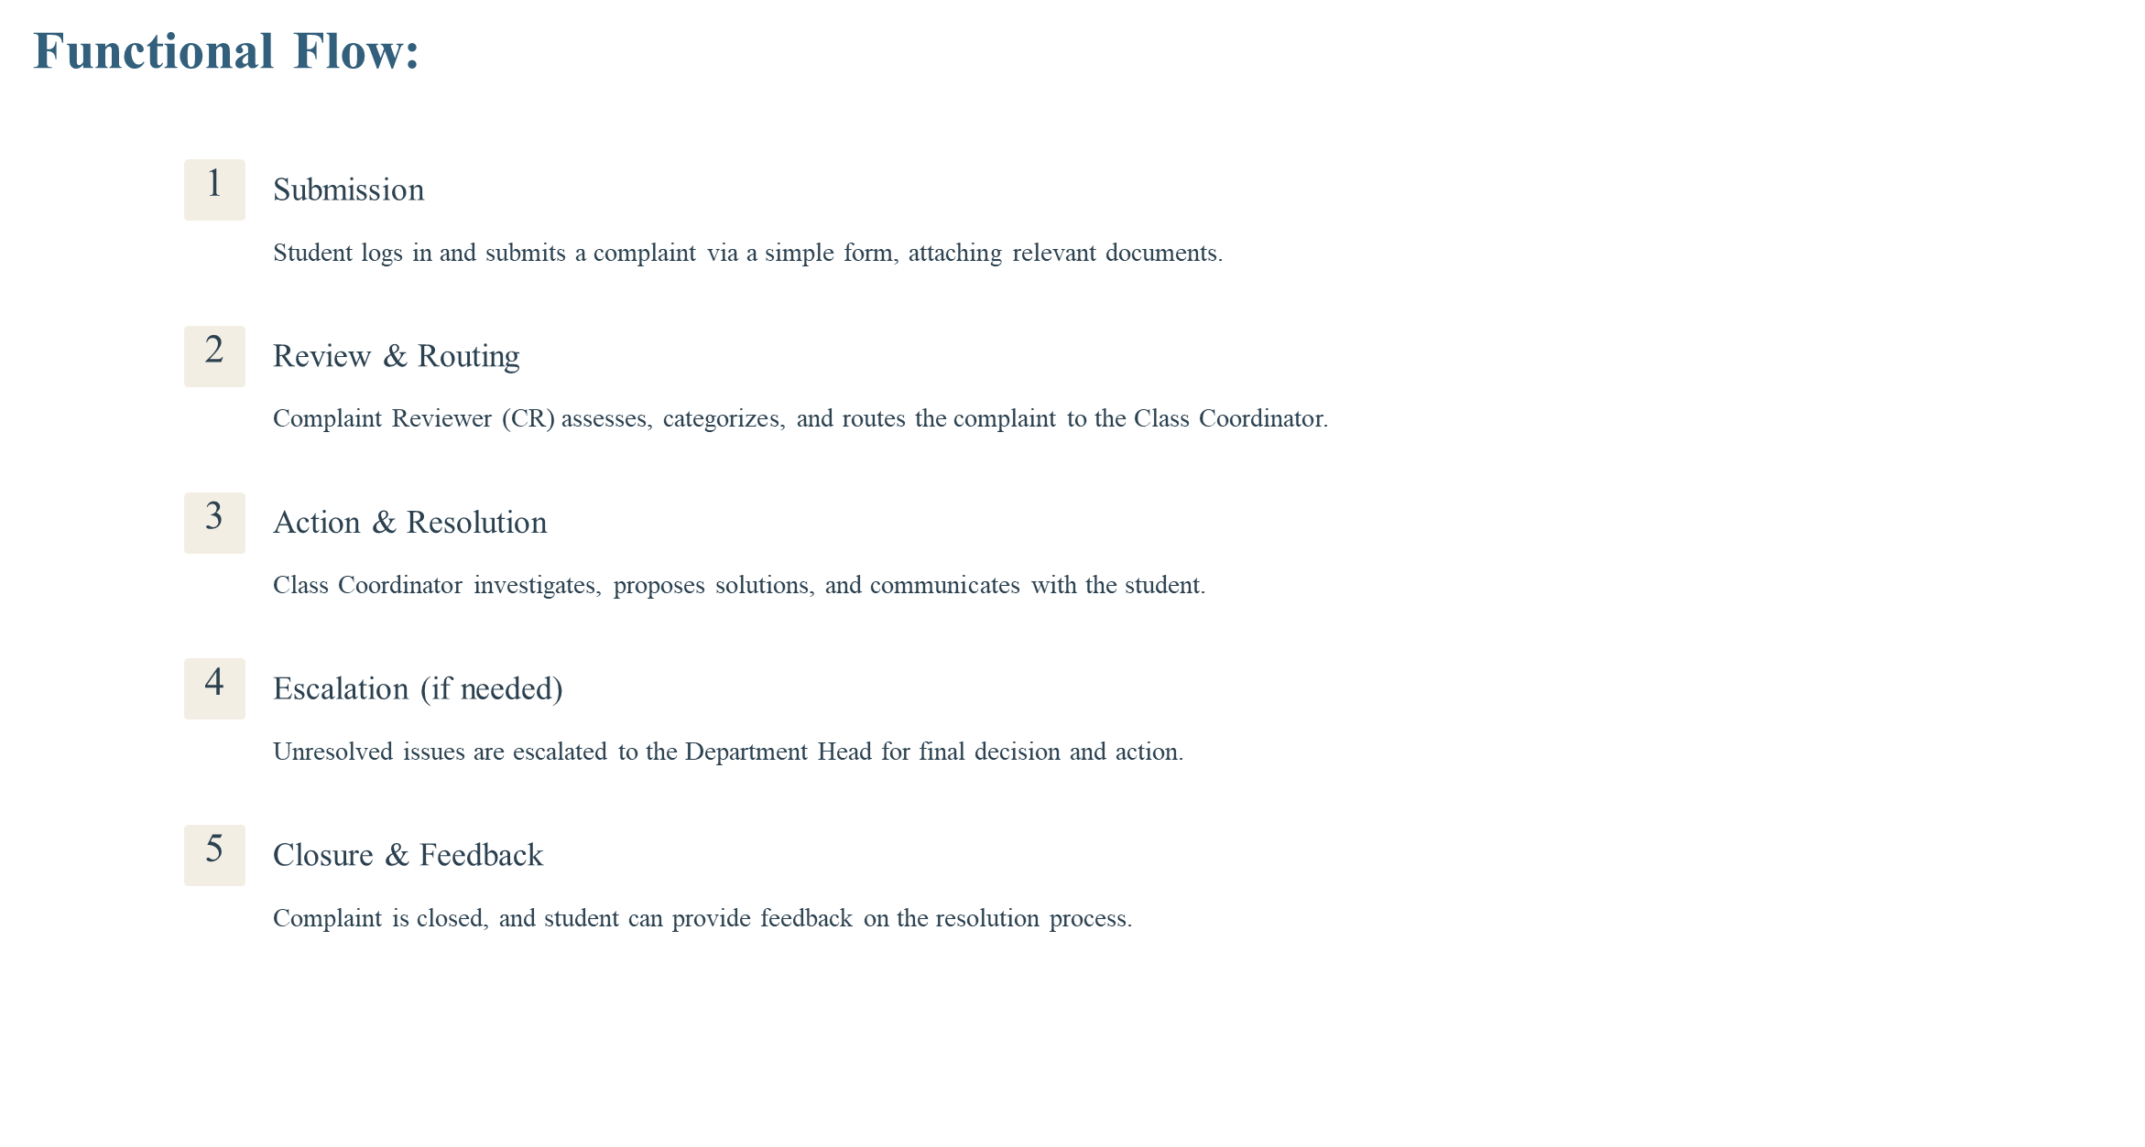

Slide 9
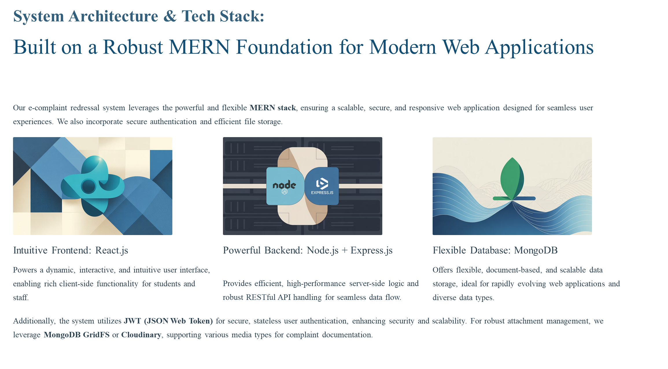

Slide 10
Methodology and Timeline:
Agile Development for Timely Delivery
We will adopt an Agile development methodology, emphasizing iterative progress, collaboration, and adaptability. This approach allows us to deliver functional components quickly and incorporate feedback throughout the project lifecycle.
Task | Duration
Requirement Analysis | 1 Week
UI/UX Design | 2 Weeks
Frontend & Backend Development | 3 Weeks
Database Setup & API Development | 2 Weeks
Testing & Debugging | 2 Weeks
Deployment & Documentation | 2 Weeks

Slide 11


Project Outcome: A More Responsive Campus
The successful implementation of the E-Complaint Redressal System will result in a fully operational web application, significantly enhancing the student experience by providing a structured, transparent, and efficient mechanism for addressing grievances. This project will serve as a foundational step towards fostering a more accountable and student-centric university environment.

